Slide 1
Greedy Algorithm
Course Code: CSC2211
Course Title: Algorithms
Dept. of Computer Science
Faculty of Science and Technology
Lecturer No: | 06 | Week No: | 06 | Semester: | Summer 22-23
Lecturer: | Pritam Khan Boni; pritam.khan@aiub.edu

Slide 2
Lecture Outline
Optimization Problem
Greedy Algorithm.
Fractional knapsack Problem.

Slide 3
Optimization Problems
An optimization problem is one in which you want to find, not just a solution, but the best solution
Example
Graph coloring optimization problem given an undirected graph, G= (V,E), what is the minimum number of colors required to assign “colors” to each vertex in such a way that no two adjacent vertices have the same color
Path optimization problem: Find the shortest path(s) from u to v in a given graph G.
a
b
Find all the shortest paths from a to d:
a →b →d
a →c →d
d
c

Slide 4
Greedy Algorithm
Solves an optimization problem
For many optimization problems, greedy algorithm can be used. (not always)
Greedy algorithm for optimization problems typically go through a sequence of steps, with a set of choices at each step. Current choice does not depend on evaluating potential future choices or pre-solving repeatedly occurring subproblems (a.k.a., overlapping subproblems). With each step, the original problem is reduced to a smaller problem.
Greedy algorithm always makes the choice that looks best at the moment.
It makes a locally optimal choice in the hope that this choice will lead to a globally optimal solution.

Slide 5
Optimal Solution
What is an Optimal Solution?
Given a problem, more than one solution exist
One of the solution is the best based on some given constraints, that solution is called the optimal solution
What is Global Optimal Solution?
Optimal Solution to the main problem
What is local Optimal Solution?
Optimal Solution to the sub-problems

Slide 6
Example of Greedy Algorithms
Activity Selection Problem
Coin Changing Problem
Job Scheduling Problem
Fractional Knapsack Problem
Dijkstra’s Shortest Path Problem
Minimum Spanning Tree Problem

Slide 7
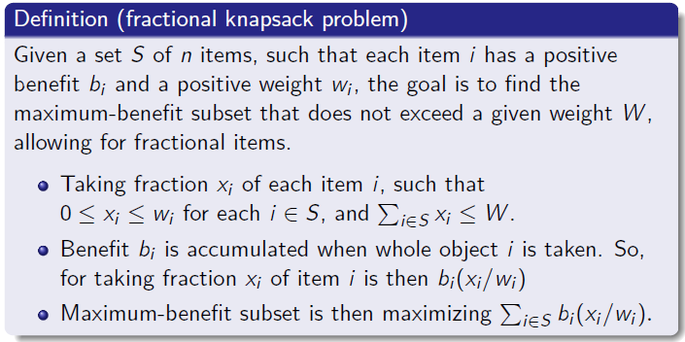
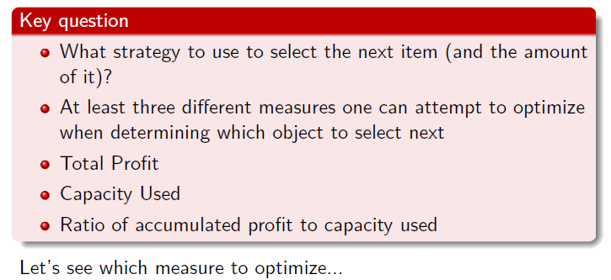
Fractional knapsack problem
24 / 38

Slide 8
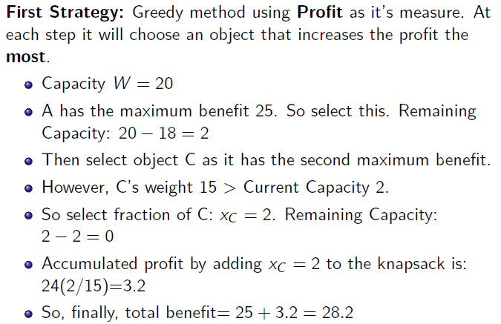
Fractional knapsack problem
Capacity W=20
Item | Benefit | Weight
A | 25 | 18 kg
B | 15 | 10 kg
C | 24 | 15 kg

Slide 9
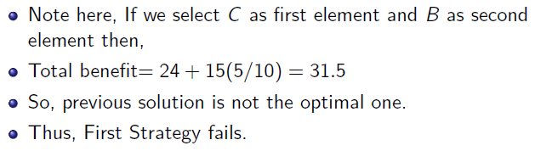
Fractional knapsack problem
Item | Benefit | Weight
A | 25 | 18 kg
B | 15 | 10 kg
C | 24 | 15 kg
27 / 38

Slide 10
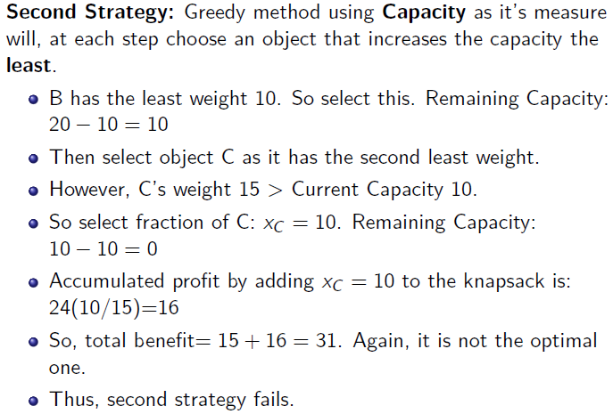
Fractional knapsack problem
28 / 38

Slide 11
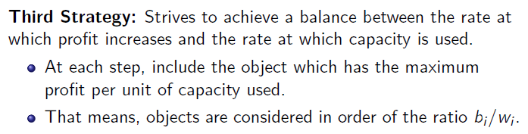
Fractional knapsack problem

Slide 12
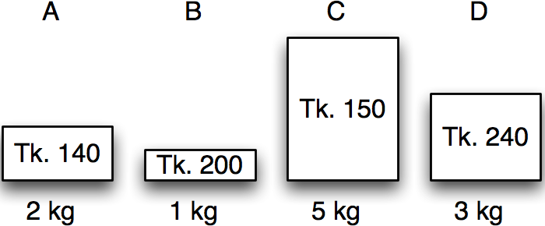
Greedy algorithms
Fractional knapsack in action
Item | Benefit | Weight
A | 140 | 2 kg
B | 200 | 1 kg
C | 150 | 5 kg
D | 240 | 3 kg
Calculate benefit/kg – the value index.

Slide 13
Greedy algorithms
Fractional knapsack in action
Item | Benefit | Weight | Value index
A | 140 | 2 kg | 70
B | 200 | 1 kg | 200
C | 150 | 5 kg | 30
D | 240 | 3 kg | 80
Sort by non-increasing value index.
Licensed under
30 / 38

Slide 14
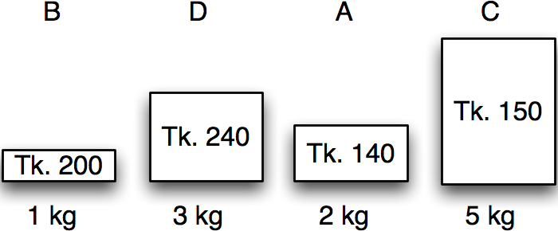
Greedy algorithms
Fractional knapsack in action
Item | Benefit | Weight | Value index
B | 200 | 1 kg | 200
D | 240 | 3 kg | 80
A | 140 | 2 kg | 70
C | 150 | 5 kg | 30
Maximum weight:
5 kg
30 / 38

Slide 15
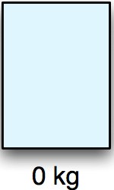
Greedy algorithms
Fractional knapsack in action
Item | Benefit | Weight | Value index | Chosen
B | 200 | 1 kg | 200 | 0 kg
D | 240 | 3 kg | 80 | 0 kg
A | 140 | 2 kg | 70 | 0 kg
C | 150 | 5 kg | 30 | 0 kg
Maximum weight:
5 kg
Remaining:
5 kg
Benefit:
0 kg
30 / 38

Slide 16
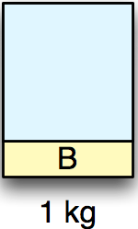
Greedy algorithms
Fractional knapsack in action
Item | Benefit | Weight | Value index | Chosen
B | 200 | 1 kg | 200 | 1 kg
D | 240 | 3 kg | 80 | 0 kg
A | 140 | 2 kg | 70 | 0 kg
C | 150 | 5 kg | 30 | 0 kg
Maximum weight:
5 kg
Remaining:
4 kg
Benefit:
200 kg
30 / 38

Slide 17
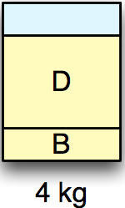
Greedy algorithms
Fractional knapsack in action
Item | Benefit | Weight | Value index | Chosen
B | 200 | 1 kg | 200 | 1 kg
D | 240 | 3 kg | 80 | 3 kg
A | 140 | 2 kg | 70 | 0 kg
C | 150 | 5 kg | 30 | 0 kg
Maximum weight:
5 kg
Remaining:
1 kg
Benefit:
440 kg
30 / 38

Slide 18
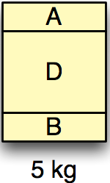
Greedy algorithms
Fractional knapsack in action
Item | Benefit | Weight | Value index | Chosen
B | 200 | 1 kg | 200 | 1 kg
D | 240 | 3 kg | 80 | 3 kg
A | 140 | 2 kg | 70 | 1 kg
C | 150 | 5 kg | 30 | 0 kg
Maximum weight:
5 kg
Remaining:
0 kg
Benefit:
510 kg
30 / 38

Slide 19
Greedy algorithms
Fractional knapsack in action
Item | Benefit | Weight | Value index | Chosen
B | 200 | 1 kg | 200 | 1 kg
D | 240 | 3 kg | 80 | 3 kg
A | 140 | 2 kg | 70 | 1 kg
C | 150 | 5 kg | 30 | 0 kg
Maximum weight:
5 kg
Remaining:
0 kg
Benefit:
510 kg
30 / 38

Slide 20
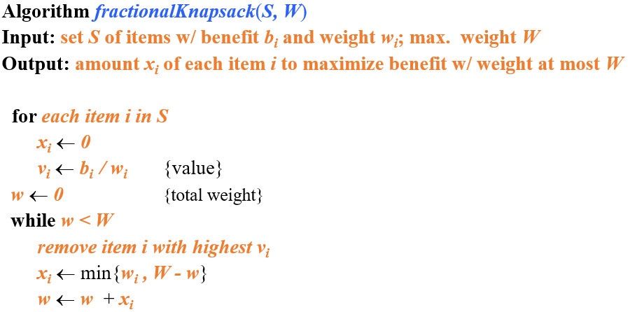
Fractional knapsack greedy algorithm

Slide 21
Fractional knapsack algorithm
Running time:
Given a collection S of n items, such that each item i has a benefit b_{i} and weight w_{i}, we can construct a maximum-benefit subset of S, allowing for fractional amounts, that has a total weight W in O(nlogn) time. (how?)
Use heap-based priority queue to store S
Removing the item with the highest value takes O(logn) time
In the worst case, need to remove all items

Slide 22
Exercise
Assume that we have a knapsack with max weight capacity, W = 16. our objective is to fill the knapsack with items such that the benefit (value or profit) is maximum. Consider the following items and their associated weight and value
ITEM | WEIGHT | VALUE
i1 | 6 | 6
i2 | 10 | 2
i3 | 3 | 1
i4 | 5 | 8
i5 | 1 | 3
i6 | 3 | 5

Slide 23
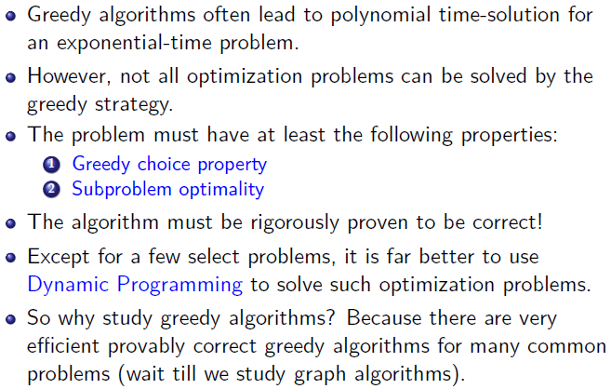
Conclusion
38 / 38

Slide 24
Books
Introduction to Algorithms, Thomas H. Cormen, Charle E. Leiserson,
Ronald L. Rivest, Clifford Stein (CLRS).
Fundamental of Computer Algorithms, Ellis Horowitz, Sartaj Sahni, Sanguthevar Rajasekaran (HSR)

Slide 25
References
https://www.tutorialspoint.com/data_structures_algorithms/greedy_algorithms.htm
https://www.geeksforgeeks.org/fractional-knapsack-problem/

